Slide 1
CSCI B609: “Foundations of Data Science”
Lecture 21/22: Massively Parallel Algorithms
Slides at http://grigory.us/data-science-class.html
Grigory Yaroslavtsev
http://grigory.us

Slide 2


Big Data = buzzword
Non-experts, media:
a lot of spreadsheets, medical data,
electropop band
…

Slide 3
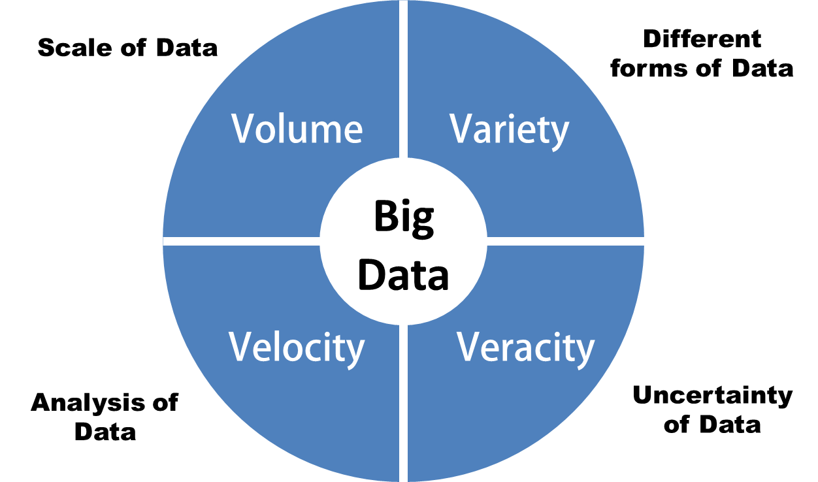

Big Data = buzzword
Business experts, analysts, data scientists:
Volume, velocity, variety, (veracity)
Databases, statistics, cloud computing, machine learning, privacy, …

Slide 4





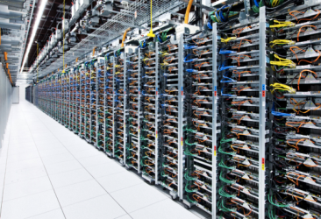

Big Data: technical definition
“Big Data” = “Data that doesn’t fit in RAM”
Massively parallel computing: MapReduce/Hadoop/Apache Spark
Streaming: Apache Storm, etc.
“algorithms for Big Data” class at Penn: http://grigory.us/big-data-class.html

Slide 5


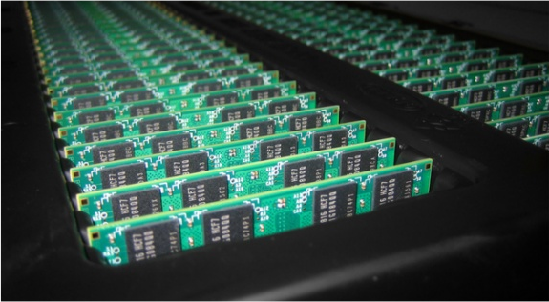
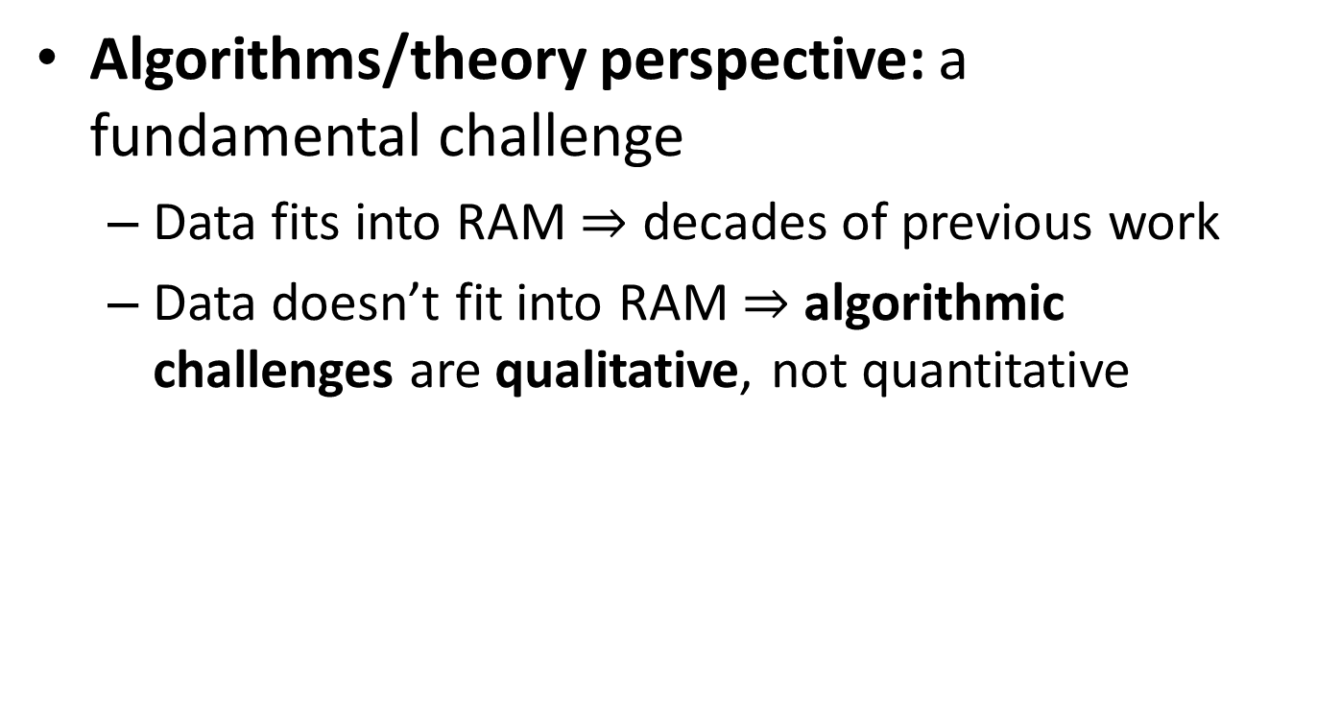
Algorithms for Big Data
Algorithms/theory perspective: a fundamental challenge
Data fits into RAM $⇒$ decades of previous work
Data doesn’t fit into RAM $⇒$ algorithmic challenges are qualitative, not quantitative

Slide 6


Algorithms for Big Data
User’s perspective: paradigm shift brought by cloud services
Outsourcing computation and data storage is great for both businesses and researchers
Cloud service providers: Amazon EC2, Google Compute Engine, …
Open source stacks/frameworks: MapReduce/Hadoop, Apache Spark, etc.

Slide 7
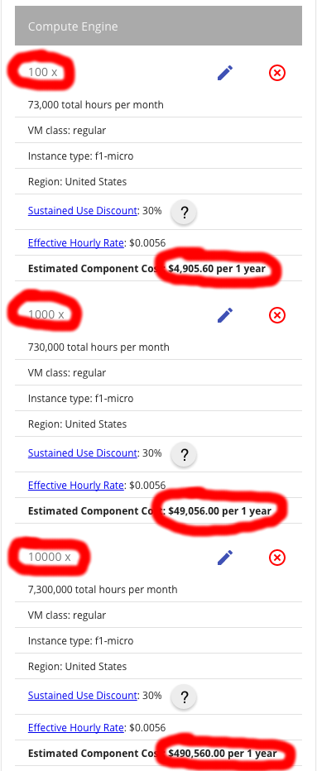
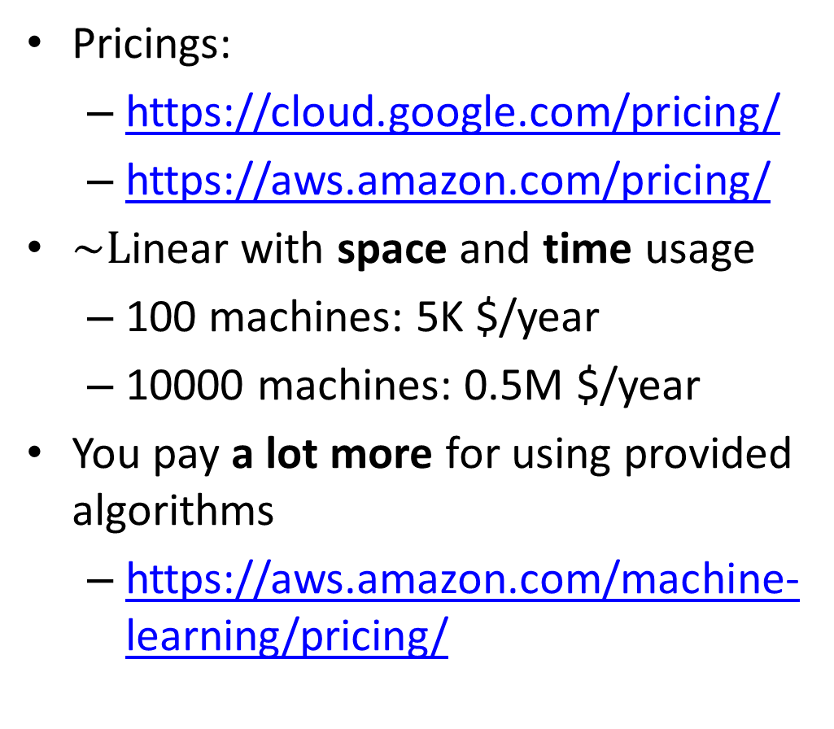
Business perspective
Pricings:
https://cloud.google.com/pricing/
https://aws.amazon.com/pricing/
$\sim L$inear with space and time usage
100 machines: 5K $/year
10000 machines: 0.5M $/year
You pay a lot more for using provided algorithms
https://aws.amazon.com/machine-learning/pricing/

Slide 8


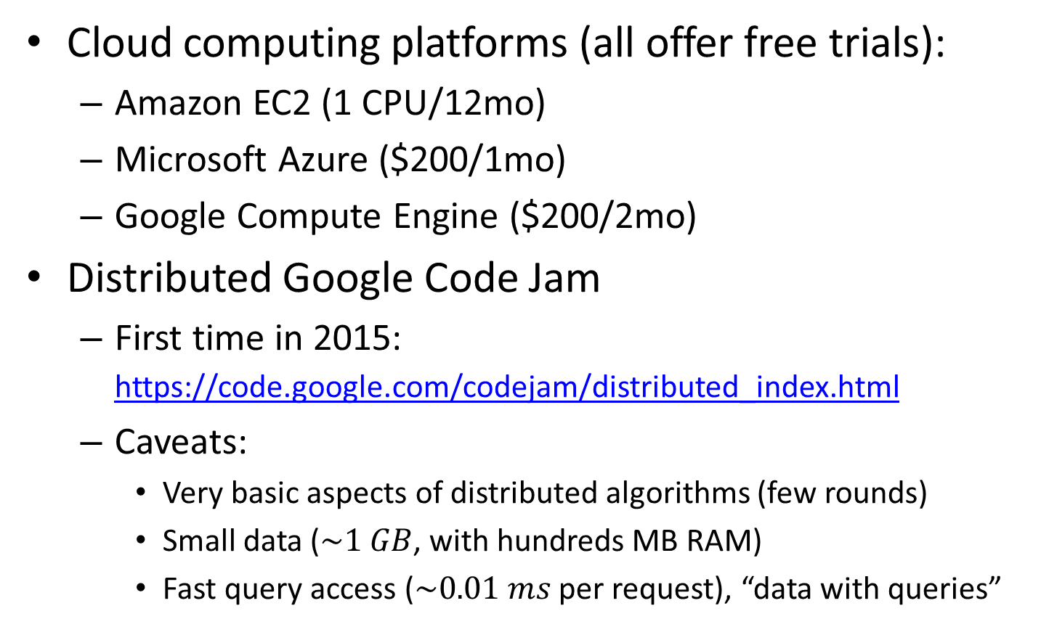
Getting hands dirty
Cloud computing platforms (all offer free trials):
Amazon EC2 (1 CPU/12mo)
Microsoft Azure ($200/1mo)
Google Compute Engine ($200/2mo)
Distributed Google Code Jam
First time in 2015: https://code.google.com/codejam/distributed_index.html
Caveats:
Very basic aspects of distributed algorithms (few rounds)
Small data ($\sim 1 GB$, with hundreds MB RAM)
Fast query access ($\sim 0.01 ms$ per request), “data with queries”

Slide 9
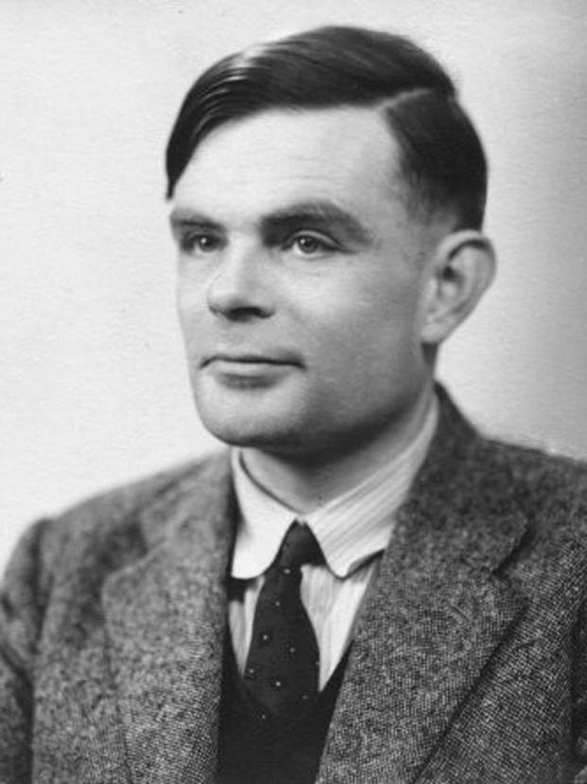

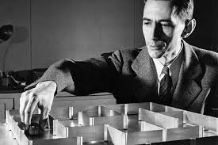

“Big Data Theory” = Turing meets Shannon
CPU time / Computational Complexity
$$=$$
+
Network Time /
Information and Communication Complexity

Slide 10
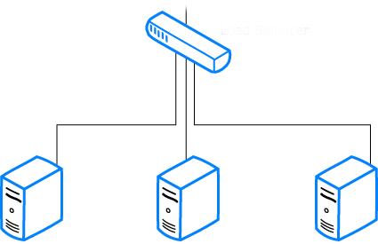

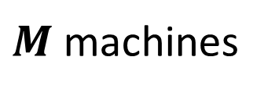
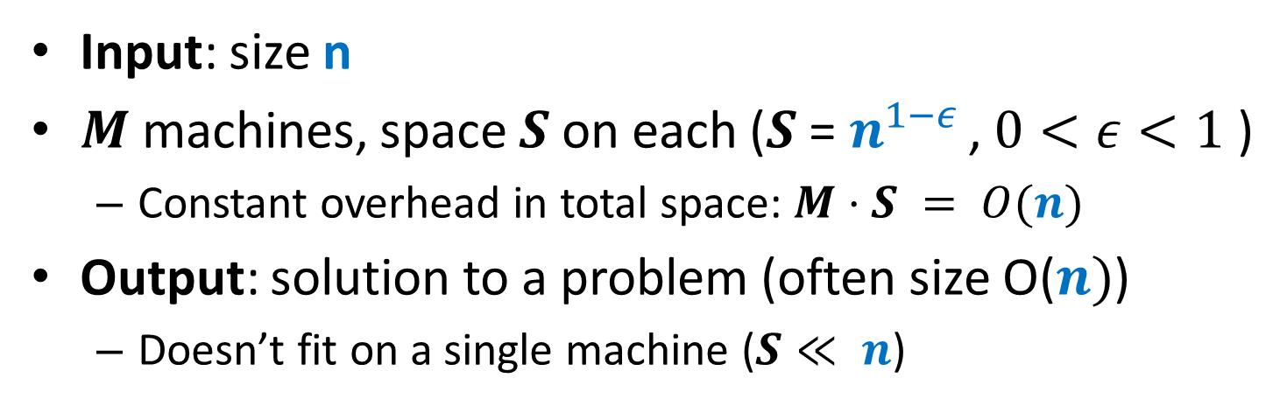

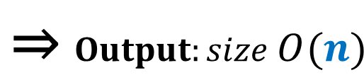

Computational Model
Input: size n
$M$ machines, space $S$ on each ($S$ = $n^{1−ε }$, $0<ε<1$ )
Constant overhead in total space: $M⋅S = O(n)$
Output: solution to a problem (often size O($n)$)
Doesn’t fit on a single machine ($S≪ n$)
$Input:size n$ ⇒
$$\text{⇒} Output:size O(n)$$
$M$machines
S space

Slide 11


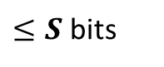
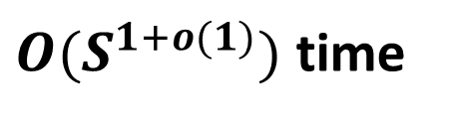
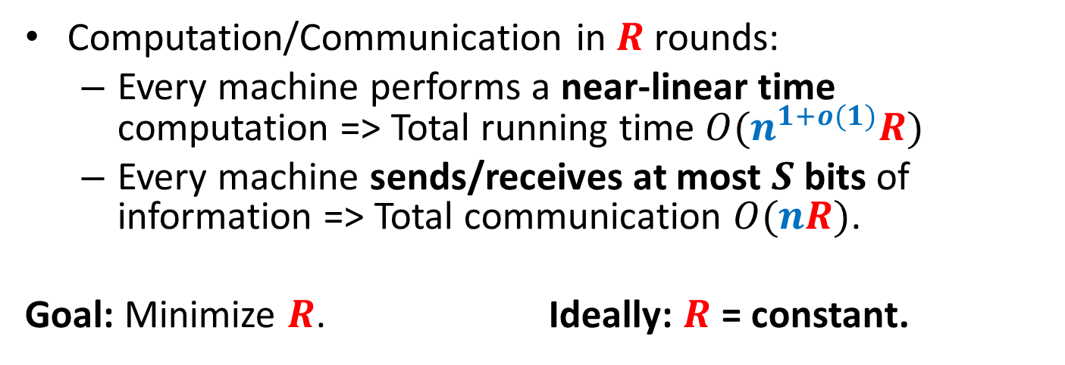
Computational Model
Computation/Communication in $R$ rounds:
Every machine performs a near-linear time computation => Total running time $O(n^{1+o(1)}R)$
Every machine sends/receives at most $S$ bits of information => Total communication $O(nR)$.
Goal: Minimize $R$. Ideally: $R$ = constant.
$≤S$ bits
$M$machines
S space
$O(S^{1+o(1)})$ time

Slide 12

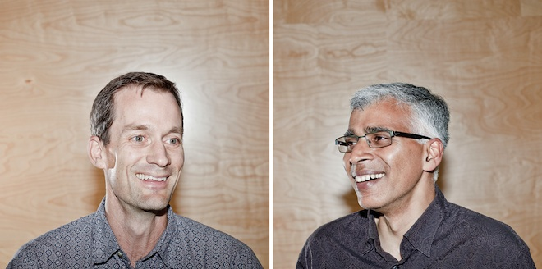


MapReduce-style computations
What I won’t discuss today
PRAMs (shared memory, multiple processors) (see e.g. [Karloff, Suri, Vassilvitskii‘10])
Computing XOR requires$\tilde{Ω}(\log{n})$ rounds in CRCW PRAM
Can be done in $O(\log_{s}{n})$ rounds of MapReduce
Pregel-style systems, Distributed Hash Tables (see e.g. Ashish Goel’s class notes and papers)
Lower-level implementation details (see e.g. Rajaraman-Leskovec-Ullman book)

Slide 13
Models of parallel computation
Bulk-Synchronous Parallel Model (BSP) [Valiant,90]
Pro: Most general, generalizes all other models
Con: Many parameters, hard to design algorithms
Massive Parallel Computation [Feldman-Muthukrishnan-Sidiropoulos-Stein-Svitkina’07, Karloff-Suri-Vassilvitskii’10, Goodrich-Sitchinava-Zhang’11, ..., Beame, Koutris, Suciu’13]
Pros:
Inspired by modern systems (Hadoop, MapReduce, Dryad, … )
Few parameters, simple to design algorithms
New algorithmic ideas, robust to the exact model specification
# Rounds is an information-theoretic measure => can prove unconditional lower bounds
Between linear sketching and streaming with sorting

Slide 14
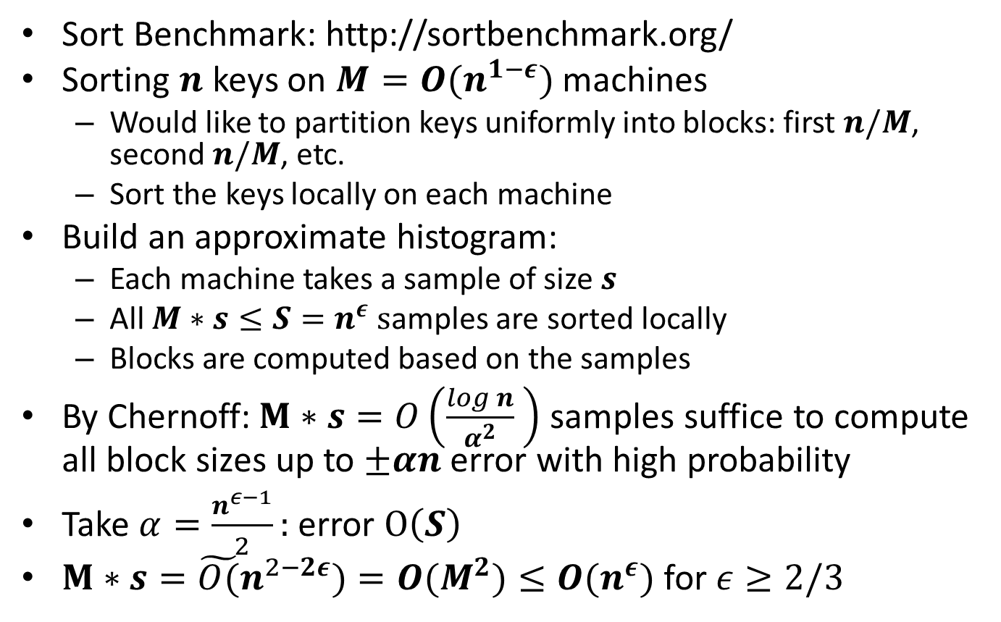
Sorting: Terasort
Sort Benchmark: http://sortbenchmark.org/
Sorting $n$ keys on $M=O(n^{1−ε})$ machines
Would like to partition keys uniformly into blocks: first $n/M$, second $n/M$, etc.
Sort the keys locally on each machine
Build an approximate histogram:
Each machine takes a sample of size $s$
All $M∗s≤S=n^{ε} s$amples are sorted locally
Blocks are computed based on the samples
By Chernoff:$M∗s=O\left(\frac{log n}{α^{2}} \right)$ samples suffice to compute all block sizes up to $±αn$ error with high probability
Take $α=\frac{n^{ε−1}}{2}:$ error $O\left(S\right)$
$M∗s={\tilde{O(}n}^{2−2ε})=O(M^{2})≤O(n^{ε})$ for $ε≥2/3$

Slide 15
Algorithms for Graphs
Dense graphs vs. sparse graphs
Dense: $S≫|V|$
Linear sketching: one round
“Filtering” (Output fits on a single machine) [Karloff, Suri Vassilvitskii, SODA’10; Ene, Im, Moseley, KDD’11; Lattanzi, Moseley, Suri, Vassilvitskii, SPAA’11; Suri, Vassilvitskii, WWW’11]
Sparse: $S≪|V|$(or $S≪$ solution size)
Sparse graph problems appear hard (Big open question: connectivity in $o(log n)$ rounds?)
VS.

Slide 16
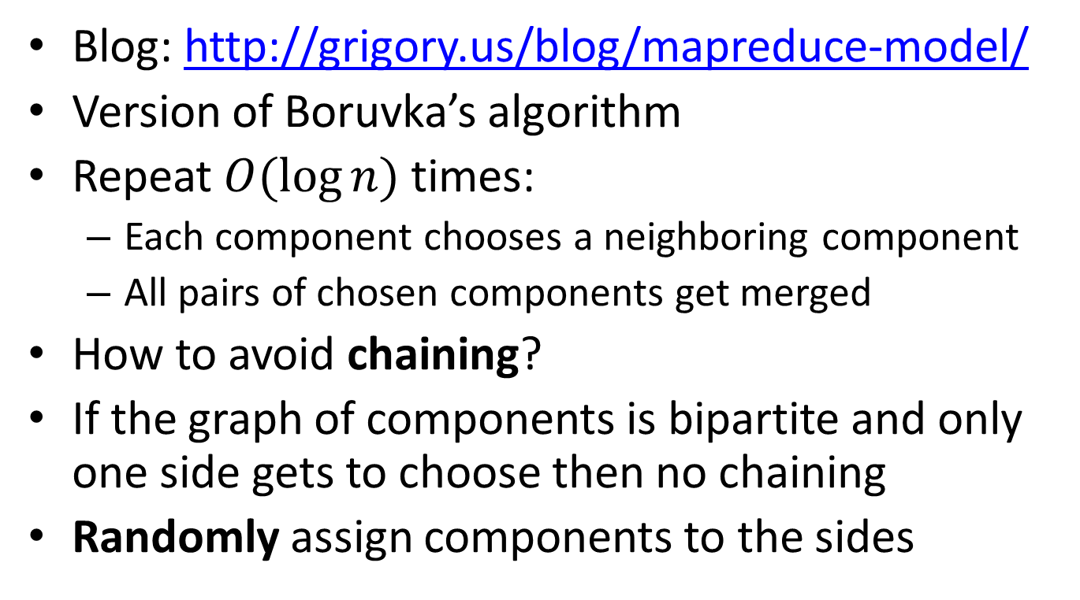
Algorithm for Connectivity
Blog: http://grigory.us/blog/mapreduce-model/
Version of Boruvka’s algorithm
Repeat $O(\log{n})$ times:
Each component chooses a neighboring component
All pairs of chosen components get merged
How to avoid chaining?
If the graph of components is bipartite and only one side gets to choose then no chaining
Randomly assign components to the sides

Slide 17
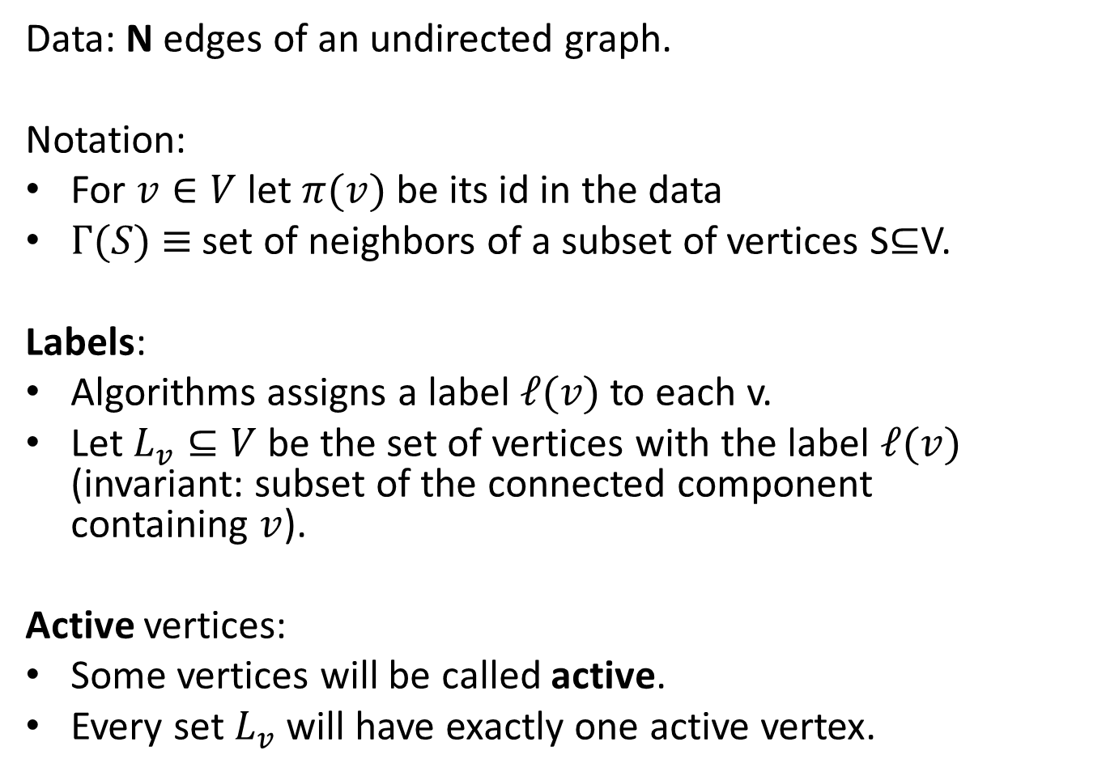
Algorithm for Connectivity: Setup
Data: N edges of an undirected graph.
Notation:
For $v∈V$ let $π(v)$ be its id in the data
$Γ(S)$ $≡$ set of neighbors of a subset of vertices S⊆V.
Labels:
Algorithms assigns a label $ℓ(v)$ to each v.
Let $L_{v}⊆V$ be the set of vertices with the label $ℓ(v)$ (invariant: subset of the connected component containing $v$).
Active vertices:
Some vertices will be called active.
Every set $L_{v}$ will have exactly one active vertex.

Slide 18
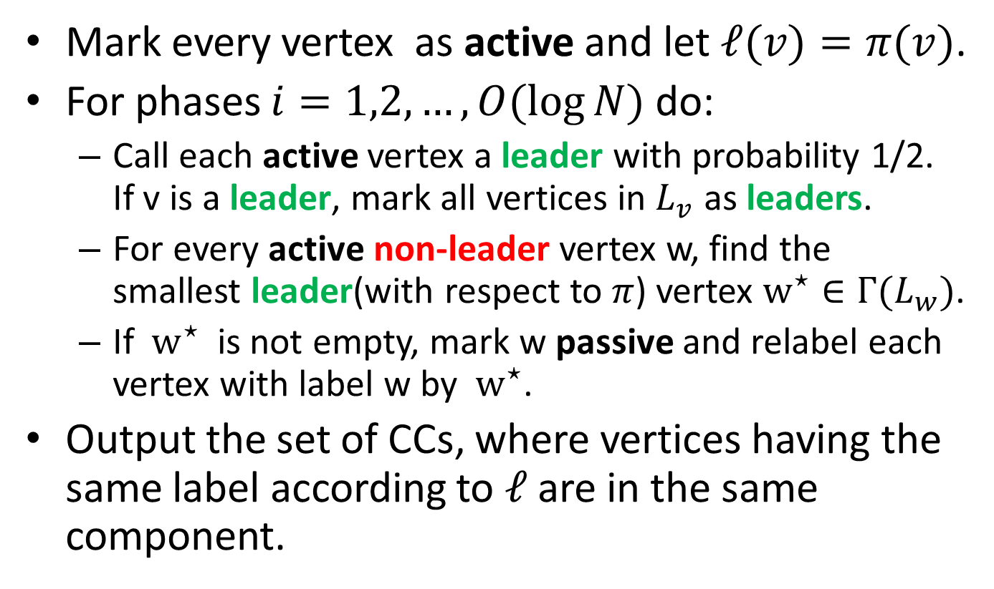
Algorithm for Connectivity
Mark every vertex as active and let $ℓ(v)=π(v)$.
For phases $i=1,2,…,O(log⁡N)$ do:
Call each active vertex a leader with probability 1/2. If v is a leader, mark all vertices in $L_{v}$ as leaders.
For every active non-leader vertex w, find the smallest leader(with respect to $π$) vertex $w^{⋆}∈Γ(L_{w})$.
If $w^{⋆}$ is not empty, mark w passive and relabel each vertex with label w by $w^{⋆}$.
Output the set of CCs, where vertices having the same label according to $ℓ$ are in the same component.

Slide 19
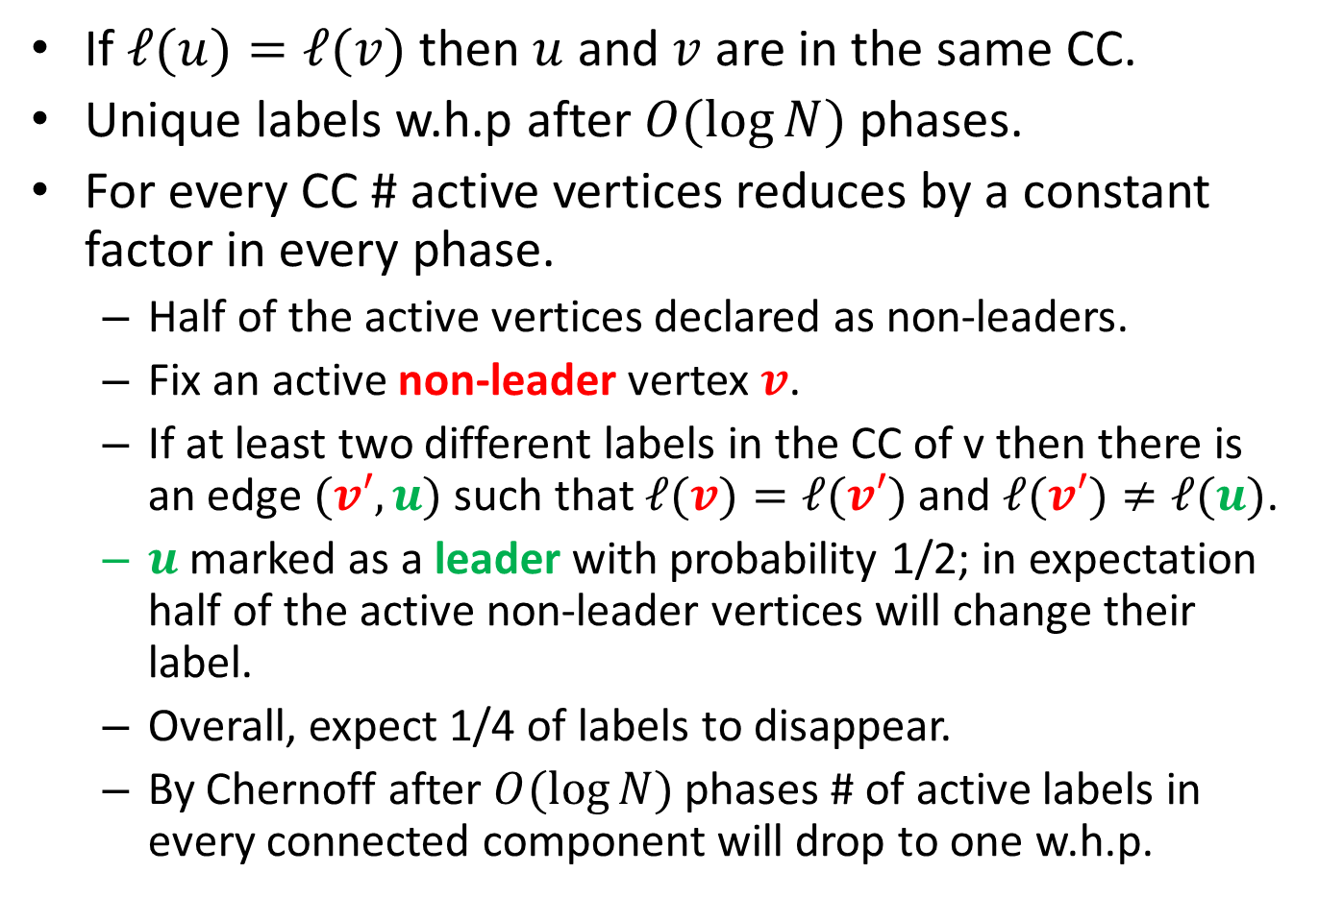
Algorithm for Connectivity: Analysis
If $ℓ(u)=ℓ(v)$ then $u$ and $v$ are in the same CC.
Unique labels w.h.p after $O(\log{N})$ phases.
For every CC # active vertices reduces by a constant factor in every phase.
Half of the active vertices declared as non-leaders.
Fix an active non-leader vertex $v$.
If at least two different labels in the CC of v then there is an edge $(v′,u)$ such that $ℓ(v)=ℓ(v′)$ and $ℓ(v′)≠ℓ(u)$.
$u$ marked as a leader with probability 1/2; in expectation half of the active non-leader vertices will change their label.
Overall, expect 1/4 of labels to disappear.
By Chernoff after $O(\log{N})$ phases # of active labels in every connected component will drop to one w.h.p.

Slide 20
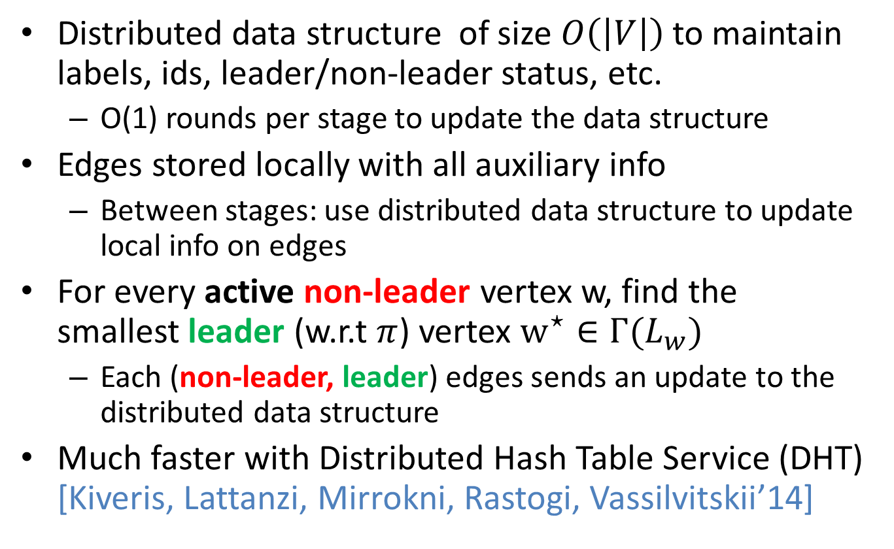
Algorithm for Connectivity: Implementation Details
Distributed data structure of size $O\left(\left|V\right|\right)$to maintain labels, ids, leader/non-leader status, etc.
O(1) rounds per stage to update the data structure
Edges stored locally with all auxiliary info
Between stages: use distributed data structure to update local info on edges
For every active non-leader vertex w, find the smallest leader (w.r.t $π$) vertex $w^{⋆}∈Γ(L_{w})$
Each (non-leader, leader) edges sends an update to the distributed data structure
Much faster with Distributed Hash Table Service (DHT) [Kiveris, Lattanzi, Mirrokni, Rastogi, Vassilvitskii’14]

Slide 21
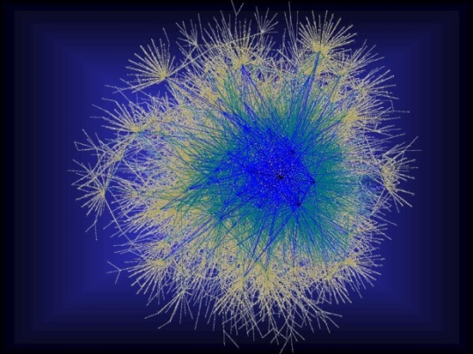
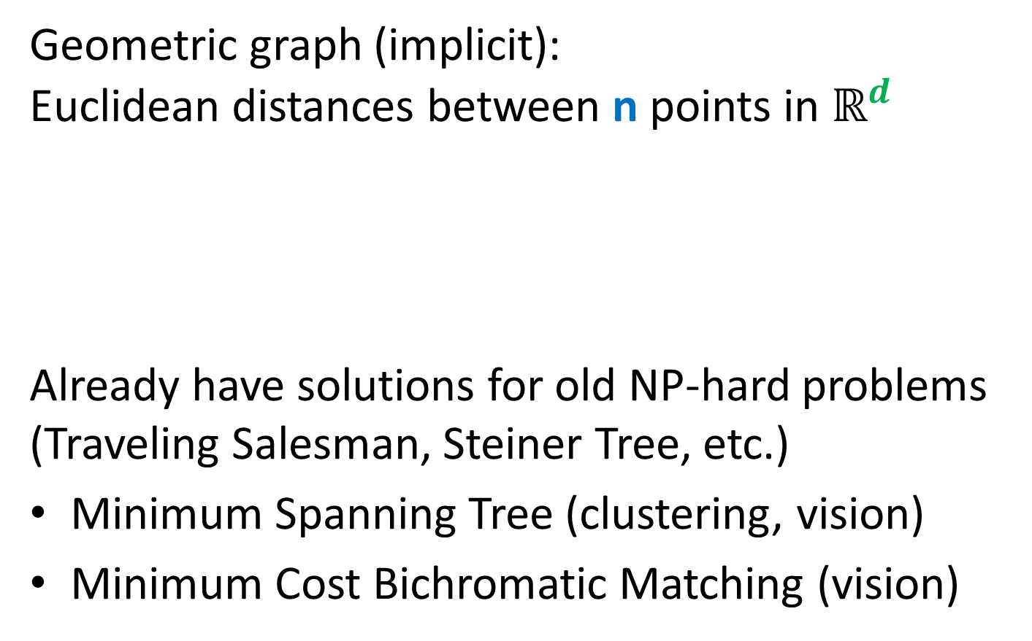
Approximating Geometric Problems in Parallel Models
Geometric graph (implicit): Euclidean distances between n points in $ℝ^{d}$
Already have solutions for old NP-hard problems (Traveling Salesman, Steiner Tree, etc.)
Minimum Spanning Tree (clustering, vision)
Minimum Cost Bichromatic Matching (vision)
Notes:
Question: do we really have an O(1)-round algorithm for TSP and Steiner Tree?

Slide 22
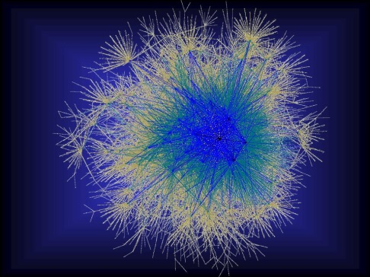



Geometric Graph Problems
Combinatorial problems on graphs in $ℝ^{d}$
Polynomial time (“easy”)
Minimum Spanning Tree
Earth-Mover Distance =
Min Weight Bi-chromatic Matching
NP-hard (“hard”)
Steiner Tree
Traveling Salesman
Clustering (k-medians, facility location, etc.)
Need new theory!
Arora-Mitchell-style “Divide and Conquer”, easy to implement in Massively Parallel Computational Models, but bad running time

Slide 23
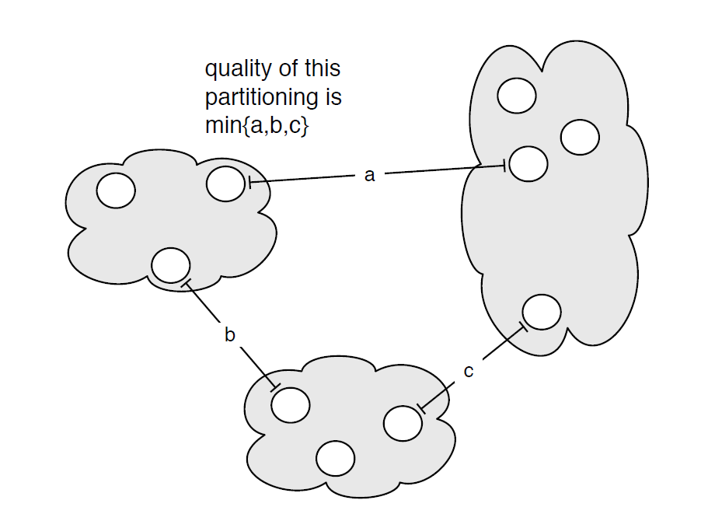
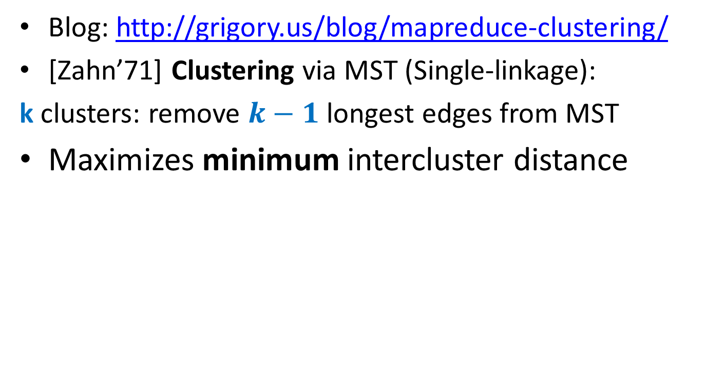
MST: Single Linkage Clustering
Blog: http://grigory.us/blog/mapreduce-clustering/
[Zahn’71] Clustering via MST (Single-linkage):
k clusters: remove $k−1$ longest edges from MST
Maximizes minimum intercluster distance
[Kleinberg, Tardos]
Notes:
“”

Slide 24
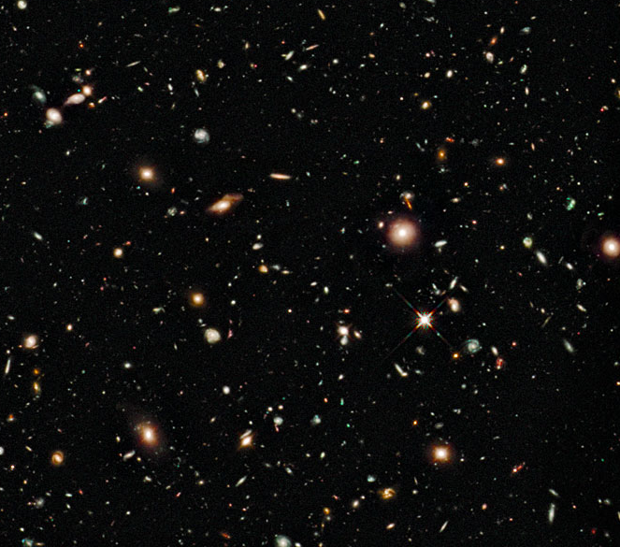
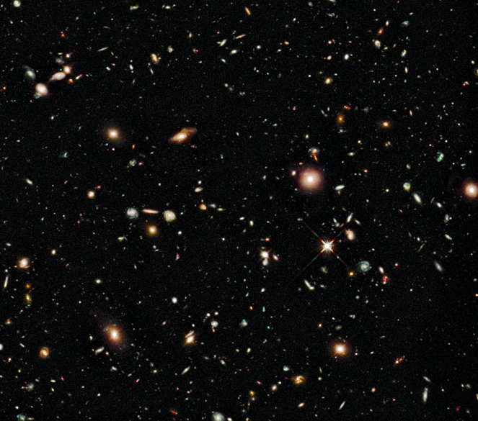
Earth-Mover Distance
Computer vision: compare two pictures of moving objects (stars, MRI scans)

Slide 25
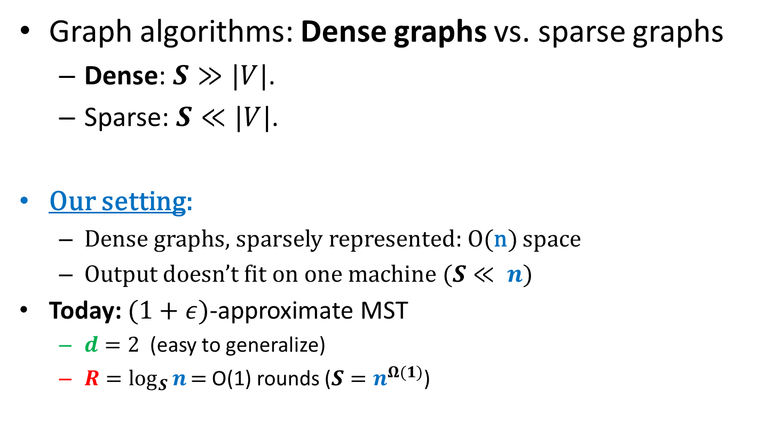
Large geometric graphs
Graph algorithms: Dense graphs vs. sparse graphs
Dense: $S≫|V|$.
Sparse: $S≪|V|$.
Our setting:
Dense graphs, sparsely represented: O(n) space
Output doesn’t fit on one machine ($S≪ n$)
Today: $(1+ε)$-approximate MST
$d=2$ (easy to generalize)
$R=\log_{S}{n}\text{= }\text{O}\text{(1) }$rounds ($S=n^{Ω(1)}$)

Slide 26
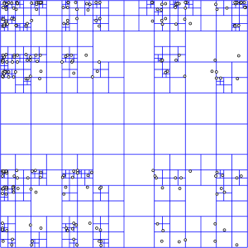
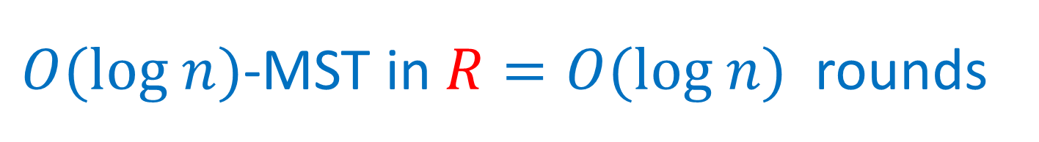
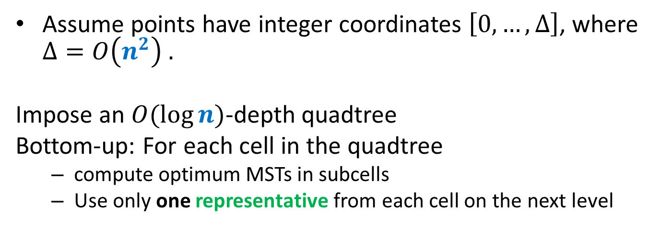
$O(log n)$-MST in $R=O(log n)$rounds
Assume points have integer coordinates $\left[0, …,Δ\right]$, where $Δ=O\left(n^{2}\right) .$
Impose an $O(log⁡n)$-depth quadtree
Bottom-up: For each cell in the quadtree
compute optimum MSTs in subcells
Use only one representative from each cell on the next level
Wrong representative:
O(1)-approximation per level

Slide 27
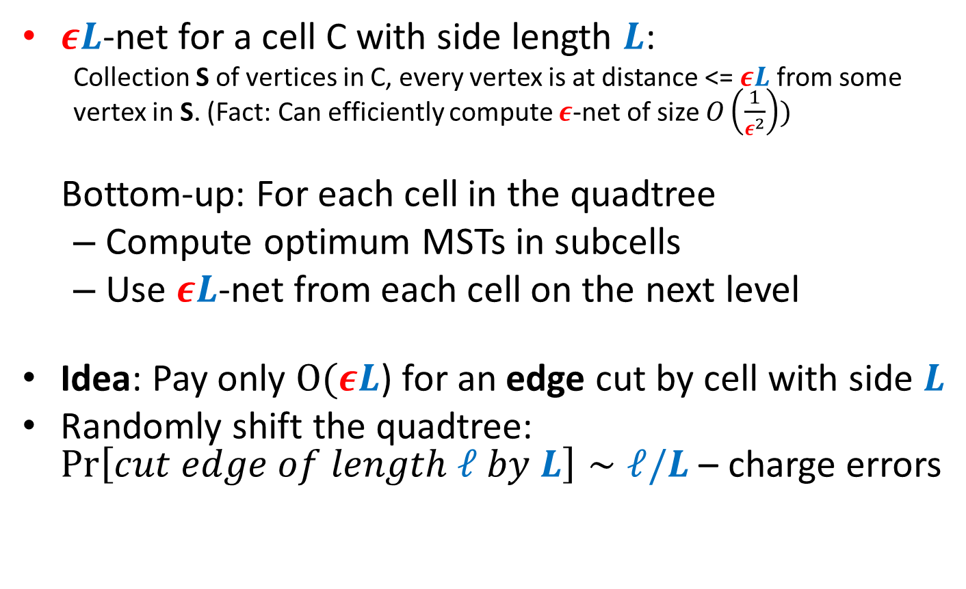




$εL$-nets
$εL$-net for a cell C with side length $L$:
Collection S of vertices in C, every vertex is at distance <= $εL$ from some vertex in S. (Fact: Can efficiently compute $ε$-net of size $O\left(\frac{1}{ε^{2}}\right))$
Bottom-up: For each cell in the quadtree
Compute optimum MSTs in subcells
Use $εL$-net from each cell on the next level
Idea: Pay only $O(εL$) for an edge cut by cell with side $L$
Randomly shift the quadtree: $\operatorname{Pr}\left[cut edge of length ℓ by L\right]∼ℓ/L$ – charge errors
Wrong representative:
O(1)-approximation per level
$$L$$
$$εL$$
$$L$$

Slide 28
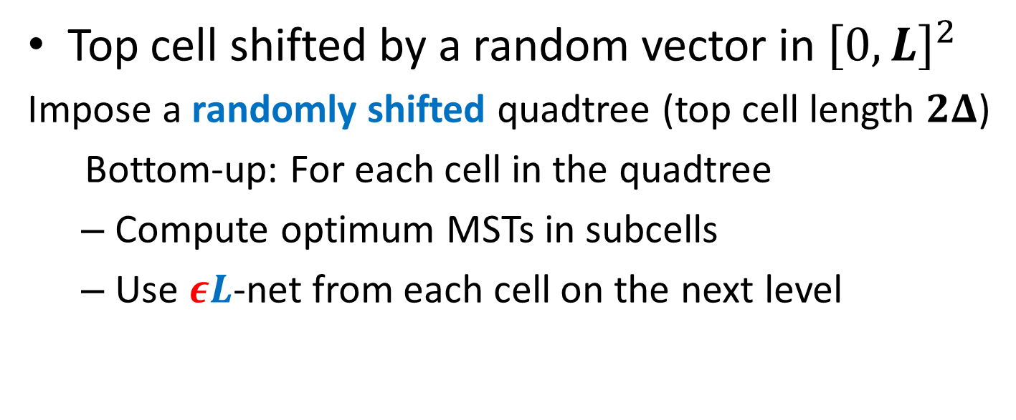


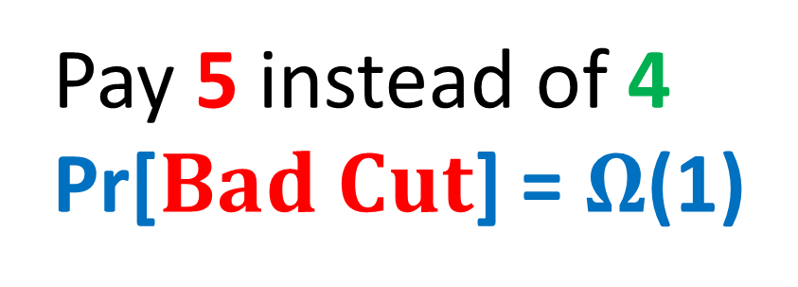
$$Randomly shifted quadtree$$
Top cell shifted by a random vector in ${\left[0,L\right]}^{2}$
Impose a randomly shifted quadtree (top cell length $2Δ$)
Bottom-up: For each cell in the quadtree
Compute optimum MSTs in subcells
Use $εL$-net from each cell on the next level
Pay 5 instead of 4
Pr[$Bad Cut$] = $Ω$(1)
2
$$Bad Cut$$
1

Slide 29
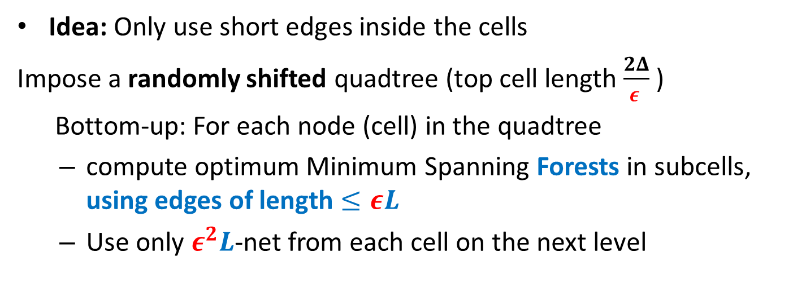
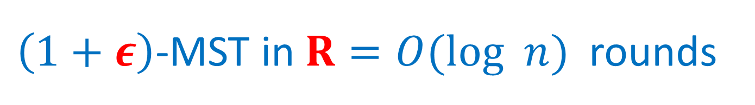
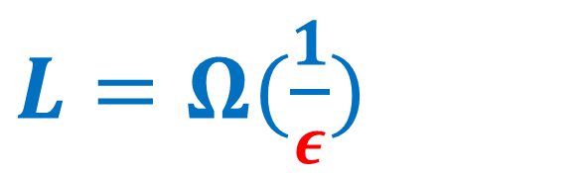
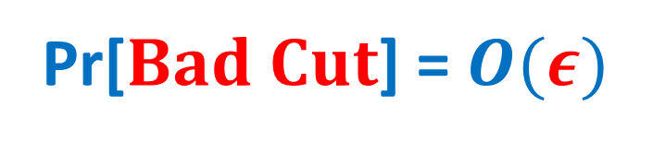
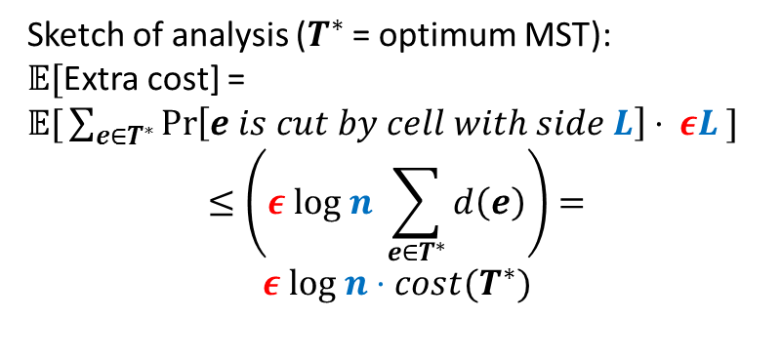
$\left(1+ε\right)$-MST in $R=O(log n)$rounds
Idea: Only use short edges inside the cells
Impose a randomly shifted quadtree (top cell length $\frac{2Δ}{ε }$ )
Bottom-up: For each node (cell) in the quadtree
compute optimum Minimum Spanning Forests in subcells, using edges of length $≤εL$
Use only $ε^{2}L$-net from each cell on the next level
Sketch of analysis ($T^{∗}$ = optimum MST):
𝔼[Extra cost] =
𝔼$\text{[}\sum_{e∈T^{∗}}{\operatorname{Pr}\left[e is cut by cell with side L\right]⋅ εL} ]$
$$≤\left(ε log n \sum_{e∈T^{∗}}{d\left(e\right)}\right)=$$
$$ε log n⋅cost(T^{∗})$$
$L=Ω(\frac{1}{ε})$
2
Pr[$Bad Cut$] = $O(ε)$
1

Slide 30
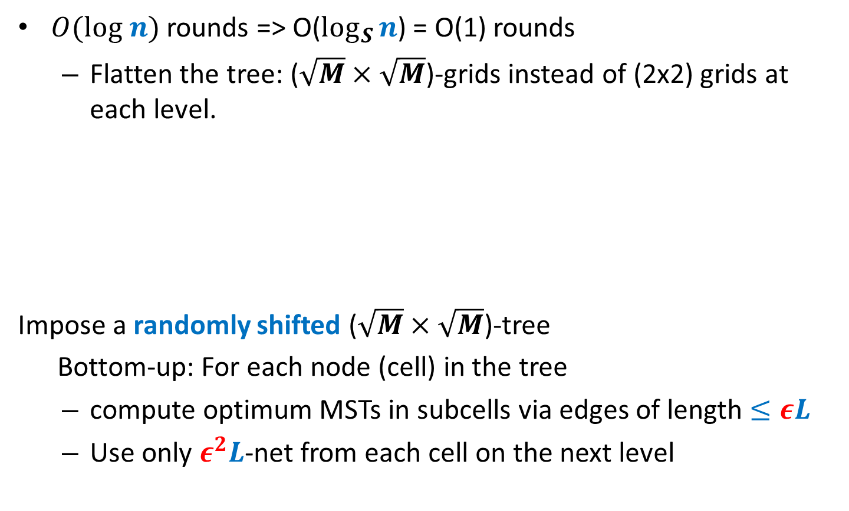
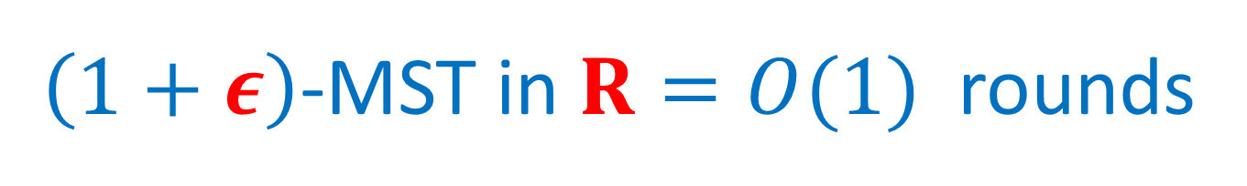
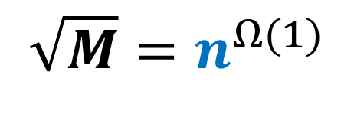

$\left(1+ε\right)$-MST in $R=O(1)$rounds
$O(log n)$ rounds => O($\log_{S}{n}$) = O(1) rounds
Flatten the tree: ($\sqrt{M}×\sqrt{M}$)-grids instead of (2x2) grids at each level.
Impose a randomly shifted ($\sqrt{M}×\sqrt{M}$)-tree
Bottom-up: For each node (cell) in the tree
compute optimum MSTs in subcells via edges of length $≤εL$
Use only $ε^{2}L$-net from each cell on the next level
$$\sqrt{M}=n^{Ω(1)}$$
⇒

Slide 31
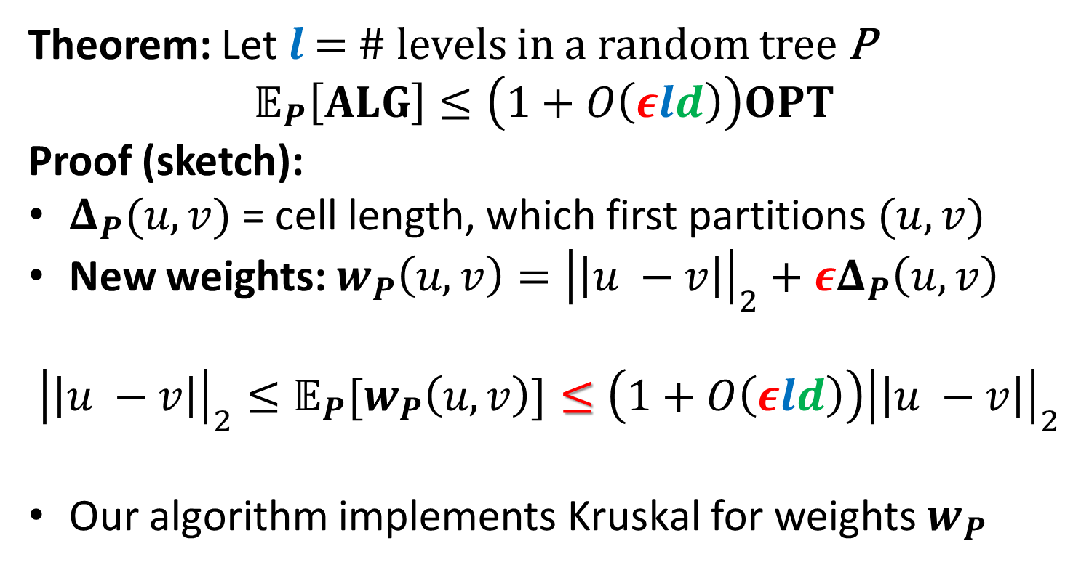
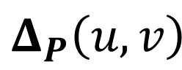
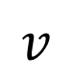
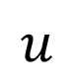
$\left(1+ε\right)$-MST in $R=O(1)$rounds
Theorem: Let $l$ = # levels in a random tree P
$$𝔼_{P}\left[ALG\right]≤\left(1+O\left(εld\right)\right)OPT$$
Proof (sketch):
$Δ_{P}(u,v)$ = cell length, which first partitions $(u, v)$
New weights: $w_{P}\left(u,v\right)={\left|\left|u −v\right|\right|}_{2}+εΔ_{P}\left(u,v\right)$
$${{\left|\left|u −v\right|\right|}_{2}≤𝔼_{P}[w}_{P}\left(u,v\right)]≤\left(1+O\left(εld\right)\right){\left|\left|u −v\right|\right|}_{2}$$
Our algorithm implements Kruskal for weights $w_{P}$
$$u$$
$$v$$
$$Δ_{P}\left(u,v\right)$$

Slide 32
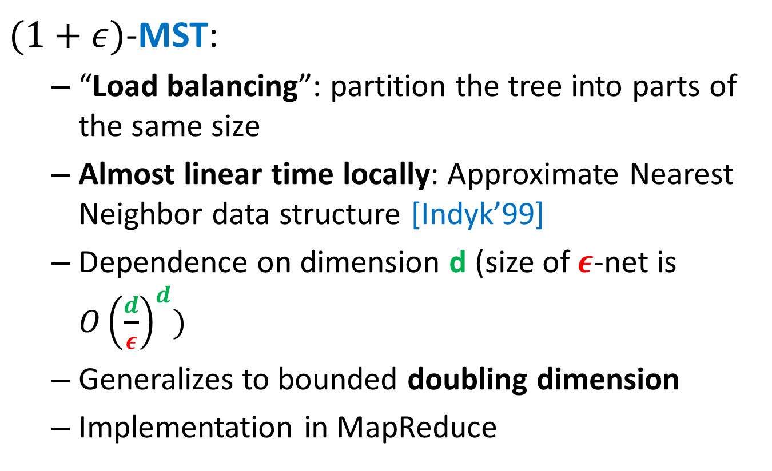
“Solve-And-Sketch” Framework
$(1+ε)$-MST:
“Load balancing”: partition the tree into parts of the same size
Almost linear time locally: Approximate Nearest Neighbor data structure [Indyk’99]
Dependence on dimension d (size of $ε$-net is ${O\left(\frac{d}{ε}\right)}^{d})$
Generalizes to bounded doubling dimension
Implementation in MapReduce

Slide 33

“Solve-And-Sketch” Framework
$(1+ε)$-Earth-Mover Distance, Transportation Cost
No simple “divide-and-conquer” Arora-Mitchell-style algorithm (unlike for general matching)
Only recently sequential $\left(1+ε\right)$-apprxoimation in $O_{ε}\left(n\log^{O\left(1\right)}{n}\right)$time [Sharathkumar, Agarwal ‘12]
Our approach (convex sketching):
Switch to the flow-based version
In every cell, send the flow to the closest net-point until we can connect the net points

Slide 34

“Solve-And-Sketch” Framework
Convex sketching the cost function for $τ$ net points
$F:ℝ^{τ−1}→ℝ$ = the cost of routing fixed amounts of flow through the net points
Function $F’=F +$ “normalization” is monotone, convex and Lipschitz, ($1+ε$)-approximates $F$
We can ($1+ε$)-sketch it using a lower convex hull

Slide 35
Thank you! http://grigory.us
More in the CIS 700 class: http://grigory.us/big-data-class.html

